Slide 1
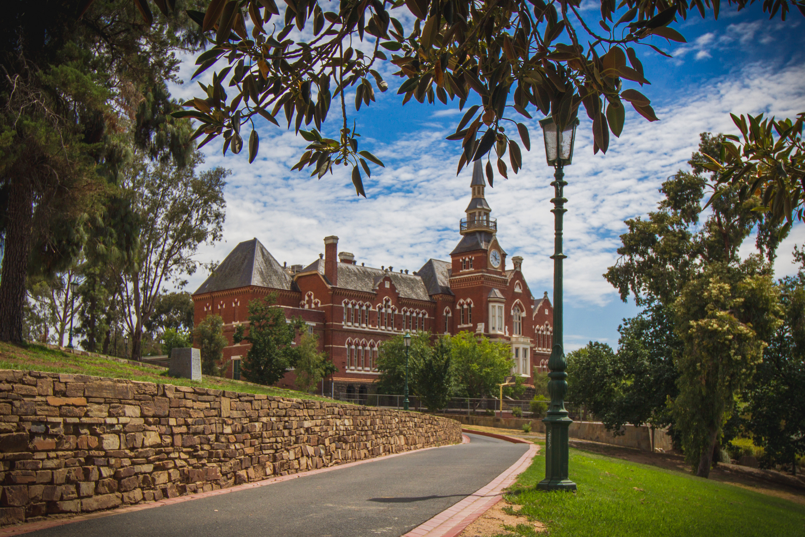
Camp Hill Primary School

Slide 2
Located in the centre of Bendigo, Camp Hill Primary School has been providing high quality education to the Bendigo community since 1877.

Slide 3
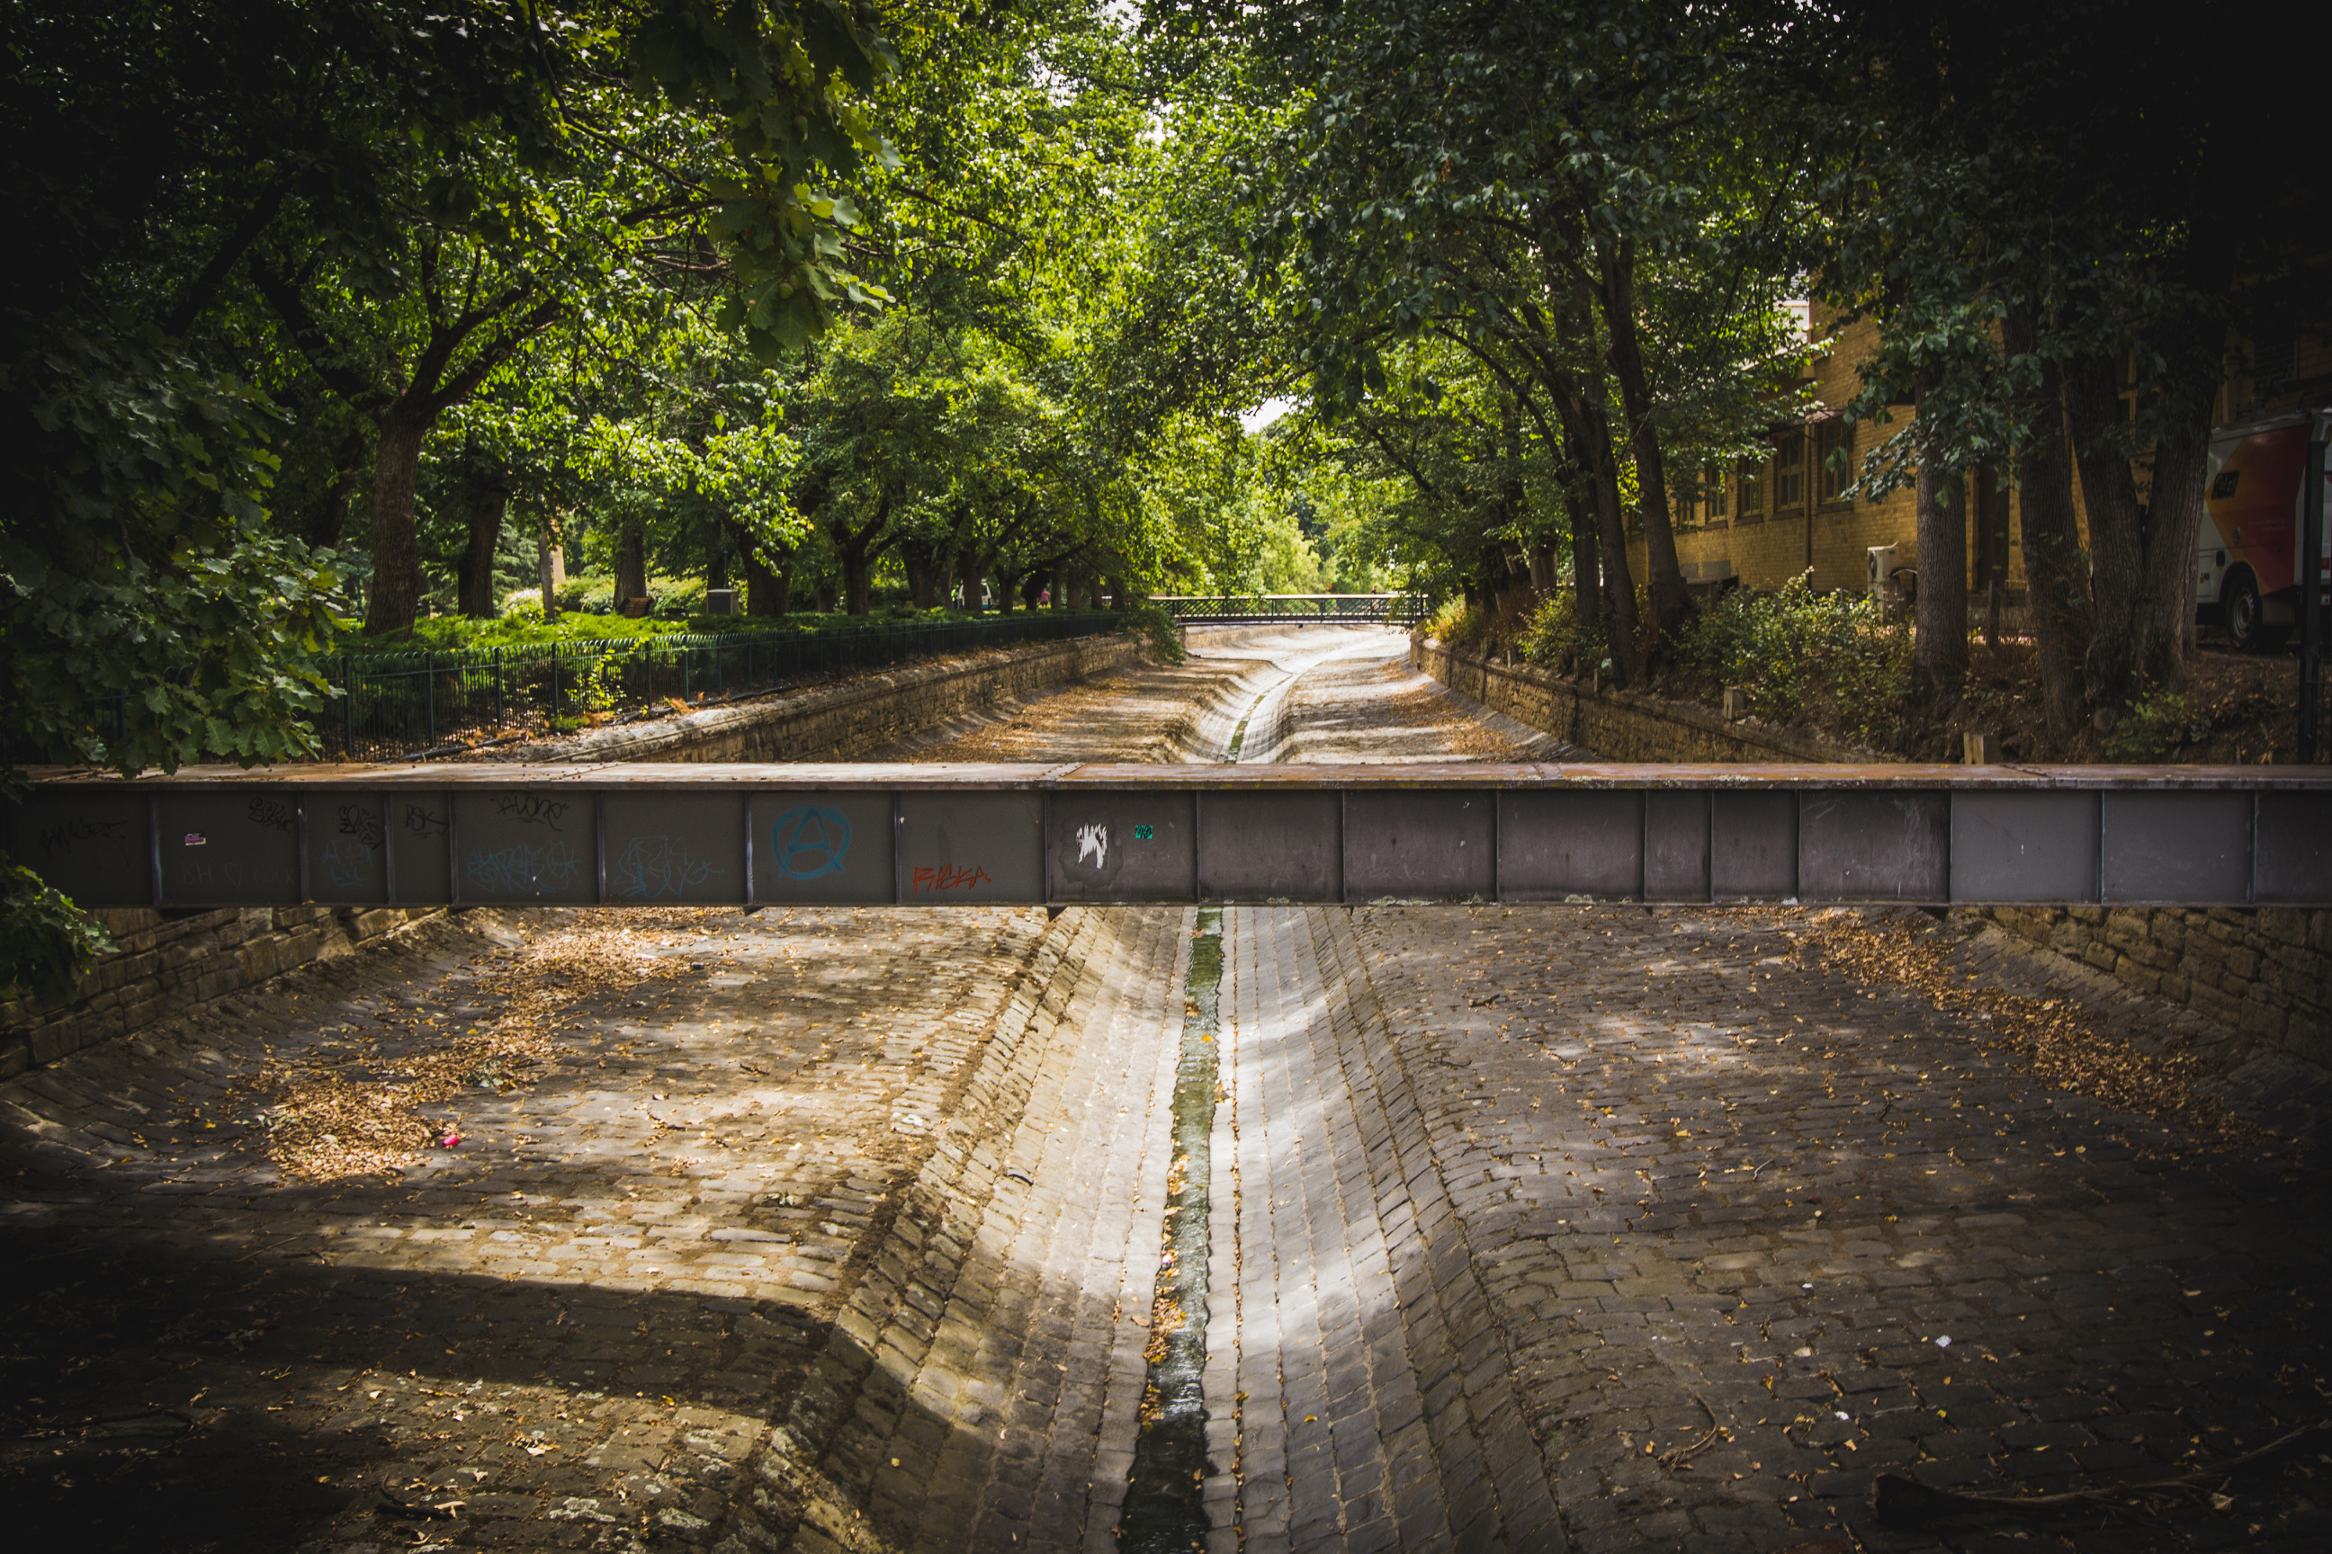
Camp Hill Primary School is a community based school which actively encourages parent participation in all facets of their child’s learning.

Slide 4
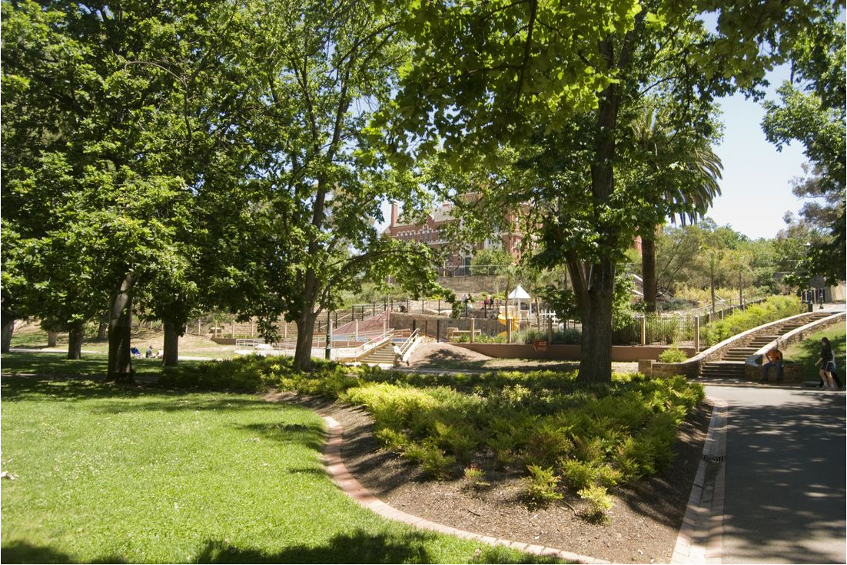
Students at Camp Hill Primary School actively reflect the values of honesty, trust, respect, confidence and caring everyday in their work and play.

Slide 5
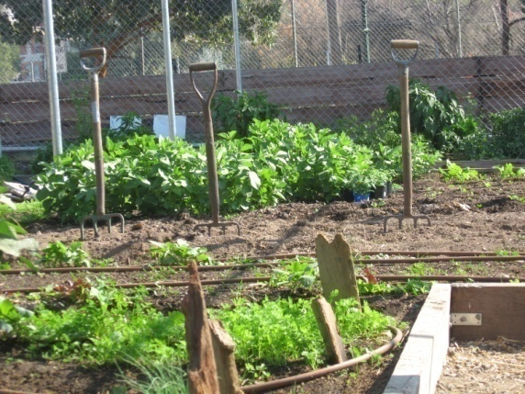
At Camp Hill we recognise the importance of living a healthy and sustainable life style.

Slide 6
Classroom programs offer students challenging and engaging learning in literacy, numeracy, science, performing arts, visual arts, Chinese language studies, inquiry learning and physical education.

Slide 7
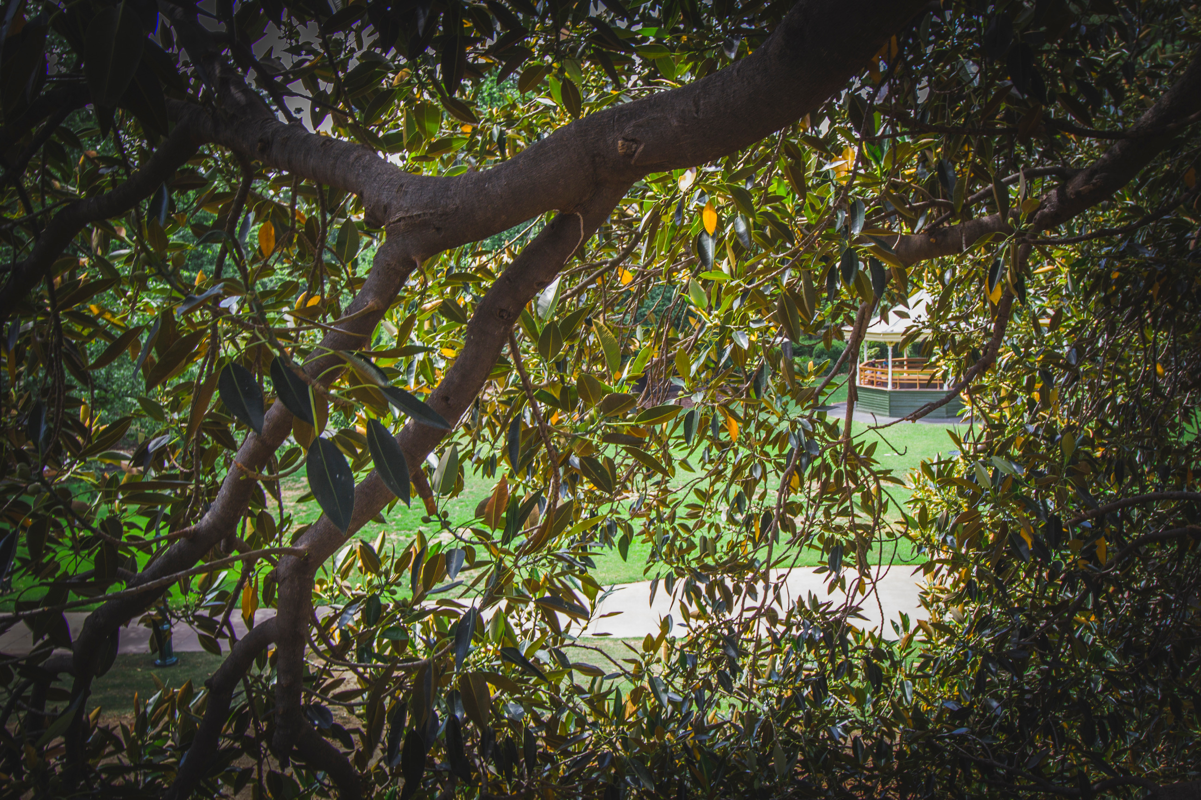
Camp Hill Primary School is famous for its Short Circus and is just one of many enrichment activities available to students.

Slide 8
Enrolments for 2021are now being taken.
Enrolment forms are available from the school website: http://www.camphillps.vic.edu.au/ or contact the school.

